Slide 1


Encryptify
SECURE FILE PROCESSING WEB APPLICATION
SECURE FILE PROCESSING WEB APPLICATION
Encryption | Decryption | Hashing | Digital Signature

Slide 2




Encryptify
INTRODUCTION
In a world where data breaches and cyber threats are increasingly common, securing sensitive information has become essential.
This project aims to develop a secure and user-friendly web application that empowers users to protect their files using core cryptographic techniques — encryption, decryption, hashing, and digital signature verification.
Our goal is to make file security both accessible and reliable, bridging the gap between cryptography theory and practical application.

Slide 3

Encryptify
KEY OBJECTIVES
Secure File Confidentiality
Ensure File Integrity
Enable Digital Authenticity
Protect files from unauthorized access using encryption techniques like AES (symmetric) and RSA (asymmetric).
Use cryptographic hash functions like SHA-256 to generate unique hash values, helping detect any alteration or corruption of files.
Incorporate digital signature generation and verification to confirm that files come from a trusted source and haven’t been tampered with.
Offer an Accessible Solution
Design a user-friendly web interface that makes file security simple and practical for everyday users without deep technical knowledge

Slide 4




Encryptify
TOOLS AND TECHNOLOGIES
We built the web app using a set of reliable tools and technologies to ensure secure and efficient file processing:
Python 3.x – Core programming language
Django – Web framework
Django Templates – Frontend
cryptography, hashlib – Cryptographic functions
Git/GitHub – Version control
VS Code – Development environment

Slide 5

Encryptify
We explored the theoretical foundations of encryption/decryption (AES, RSA), hashing (SHA-256), and digital signatures by studying their algorithms, security protocols, and use cases. We also analyzed existing solutions, identifying key strengths like strong cryptographic protection and weaknesses such as complexity, limited usability, or lack of integration between features.
DATA
GATHERING
PHASE

Slide 6
DEVELOPMENT PHASES 1/2
Encryptify
Phase 1: Planning & Requirements
Define supported operations (AES, RSA, SHA-256), file handling flow, and tools needed.
Phase 2: Environment Setup
Initialize the Django project, configure templates, and install dependencies like PyCryptodome.
Phase 3: Backend Development
Implement hashing, encryption (symmetric & asymmetric), decryption, and key management modules.
Phase 4: Frontend Development
Create a simple UI for file upload, operation selection, and download using Django templates.
Phase 5: Integration & Testing
Connect the frontend and backend, test functionality, and ensure accuracy of cryptographic operations.

Slide 7
DEVELOPMENT PHASES 2/2
Encryptify
Phase 6: Security Enhancements
Add input validation, secure file handling, and basic error management.
Phase 7: Documentation
Prepare user and technical documentation, including setup and usage instructions.
Phase 8: Finalization
Polish the UI, clean the codebase, and prepare the final demo and deliverables.

Slide 8
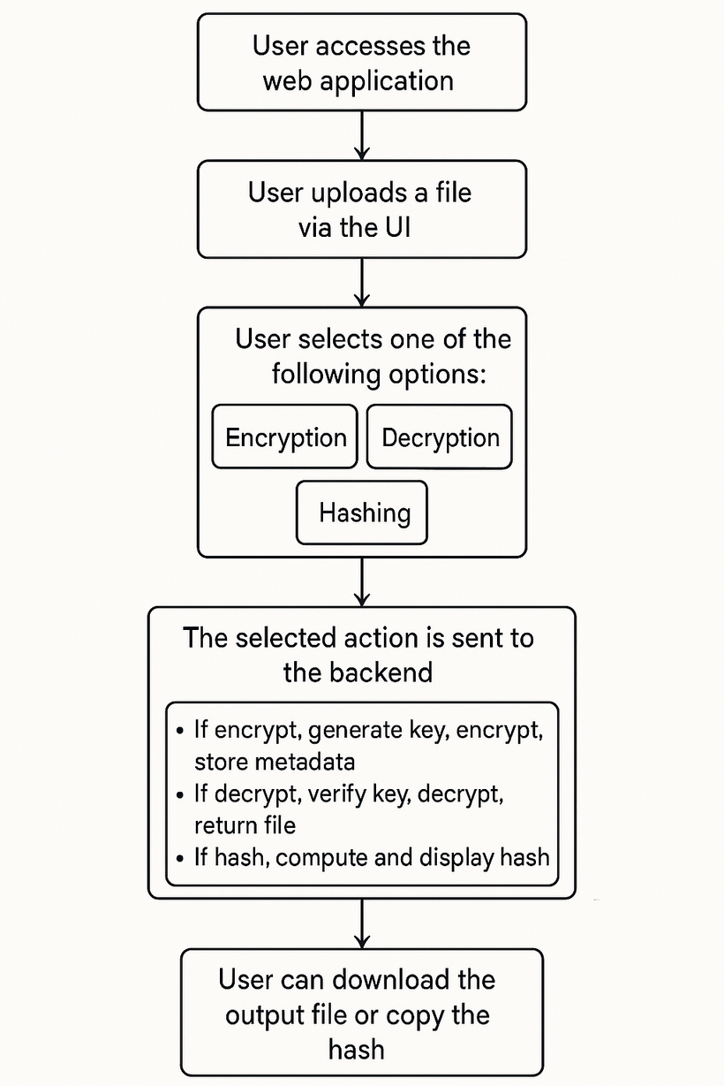
Encryptify
DESIGN DIAGRAM

Slide 9

Encryptify
BACKEND
IMPLEMENTATION

Slide 10
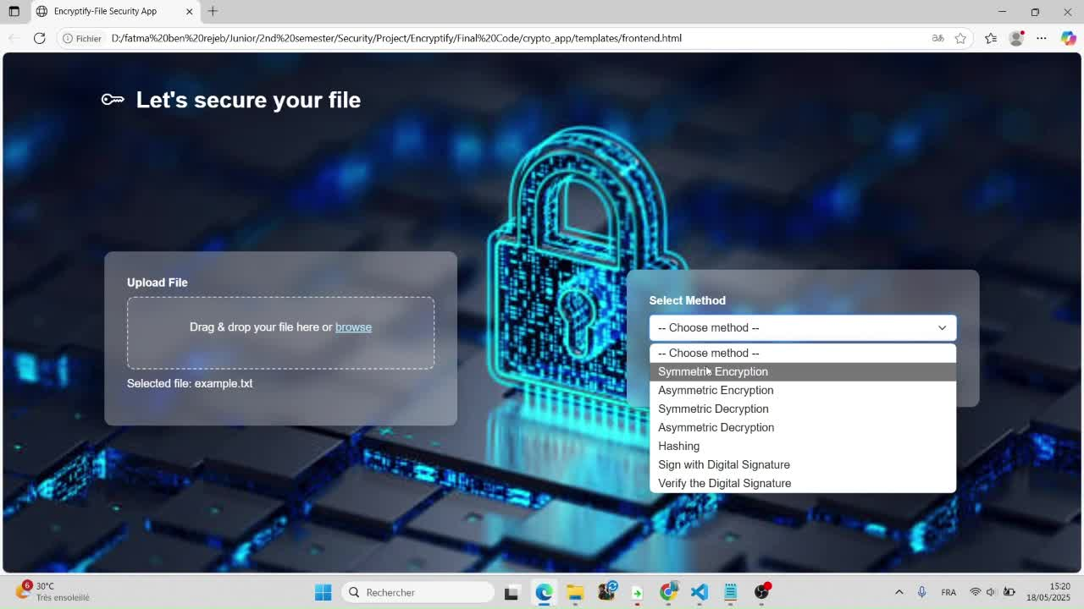
Encryptify
ENCRYPTION & DECRYPTION
Supports both symmetric (AES) and asymmetric (RSA) encryption methods.

Slide 11
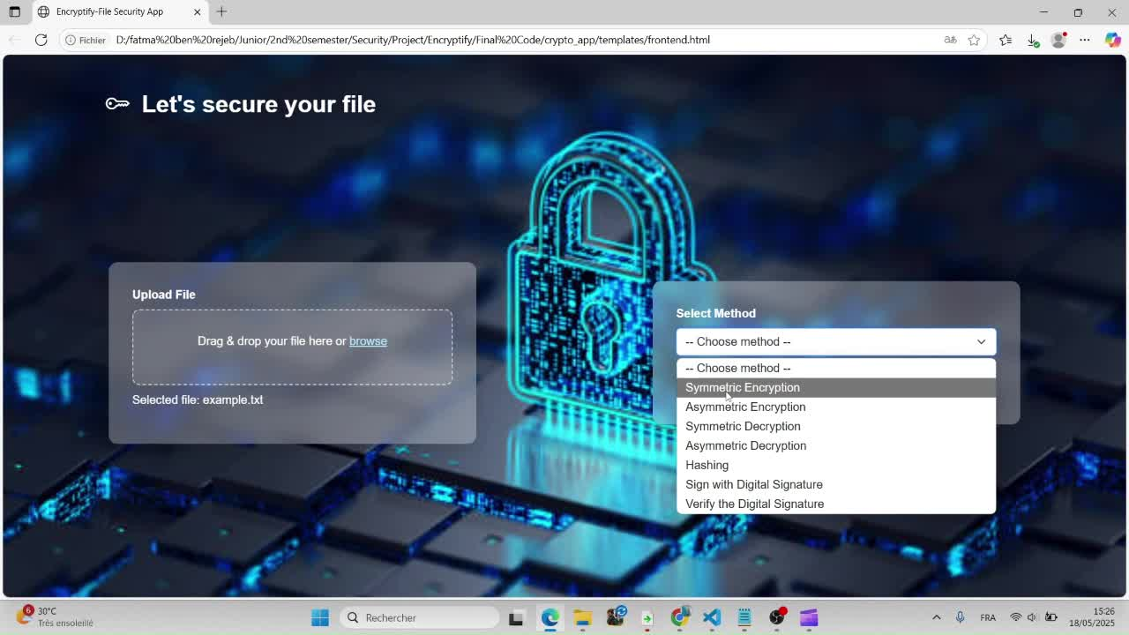
Encryptify
HASHING
Computes secure hashes ( SHA-256) of uploaded files.

Slide 12
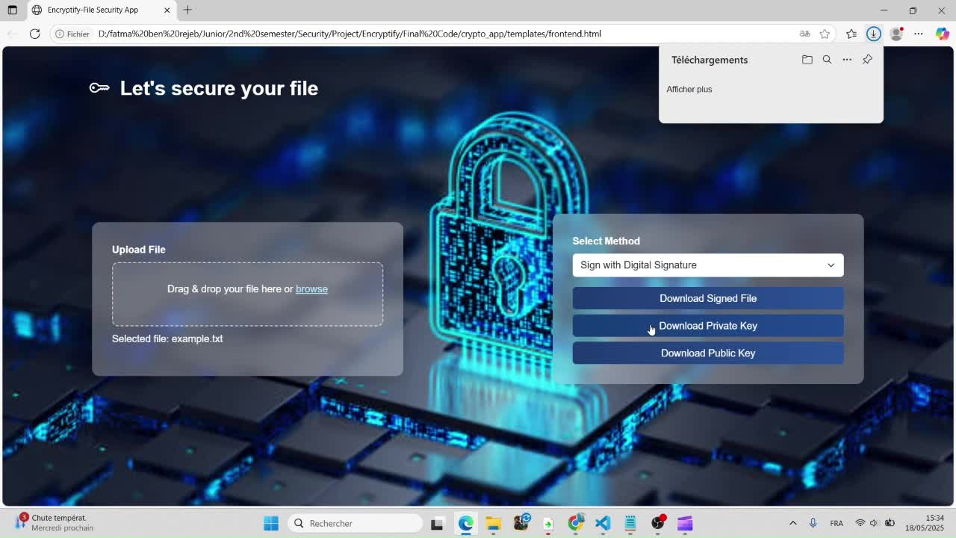
Encryptify
DIGITAL SIGNATURE
We added a digital signature verification step to authenticate the file’s origin.
It uses the sender’s private key to sign, and the receiver can verify using the public key.

Slide 13
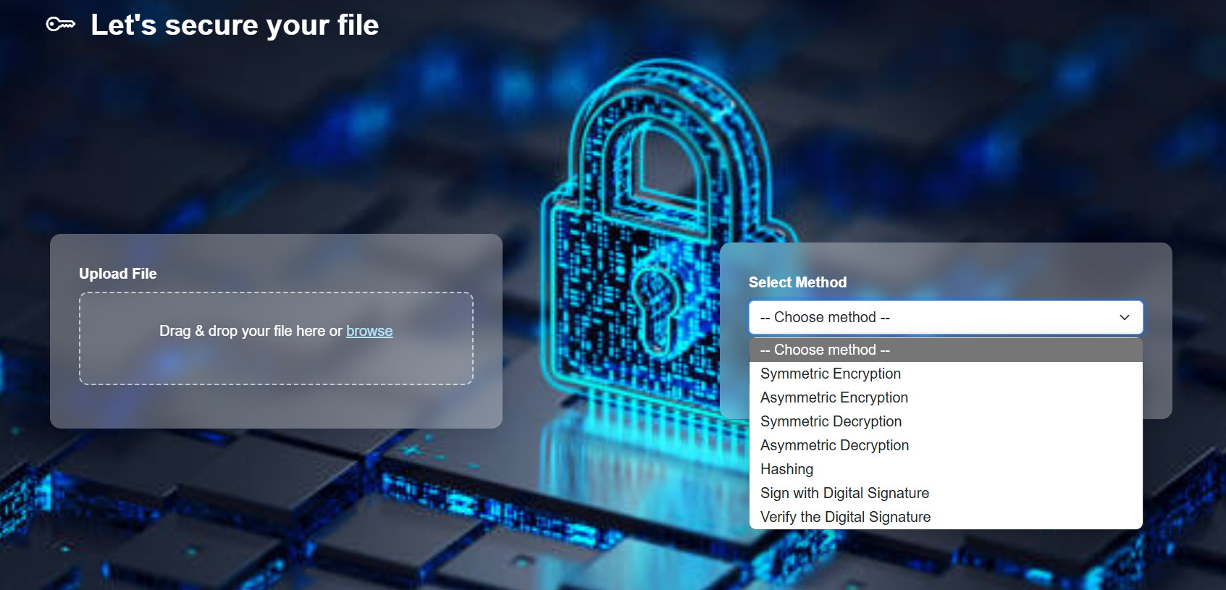
FINAL OUTPUT (FRONTEND)
Encryptify

Slide 14
Encryptify
CONCLUSION
This project delivers a simple yet powerful web app that applies encryption, hashing, and digital signatures to ensure file security. It bridges cryptographic theory with real-world usability, offering users a secure and accessible way to protect their data.

Slide 15
Encryptify
REFERENCES
National Institute of Standards and Technology (NIST)
FIPS PUB 197: Advanced Encryption Standard (AES)
FIPS 180-4: Secure Hash Standard (SHA)
SP 800-38: Recommendation for Block Cipher Modes of Operation
SP 800-185: SHA-3 Standard
Rivest, R., Shamir, A., & Adleman, L. (1978)
A Method for Obtaining Digital Signatures and Public-Key Cryptosystems
Bruce Schneier (2017)
Applied Cryptography: Protocols, Algorithms, and Source Code in C
William Stallings (2020)
Cryptography and Network Security: Principles and Practice
5.OpenSSL Documentation
6.GitHub Project Repository

Slide 16

Encryptify
THANK YOU
FOR YOUR ATTENTION

